Slide 1


Connecting Organisations for Societal Impact
Ben Vivekanandan
September 2020

Slide 2
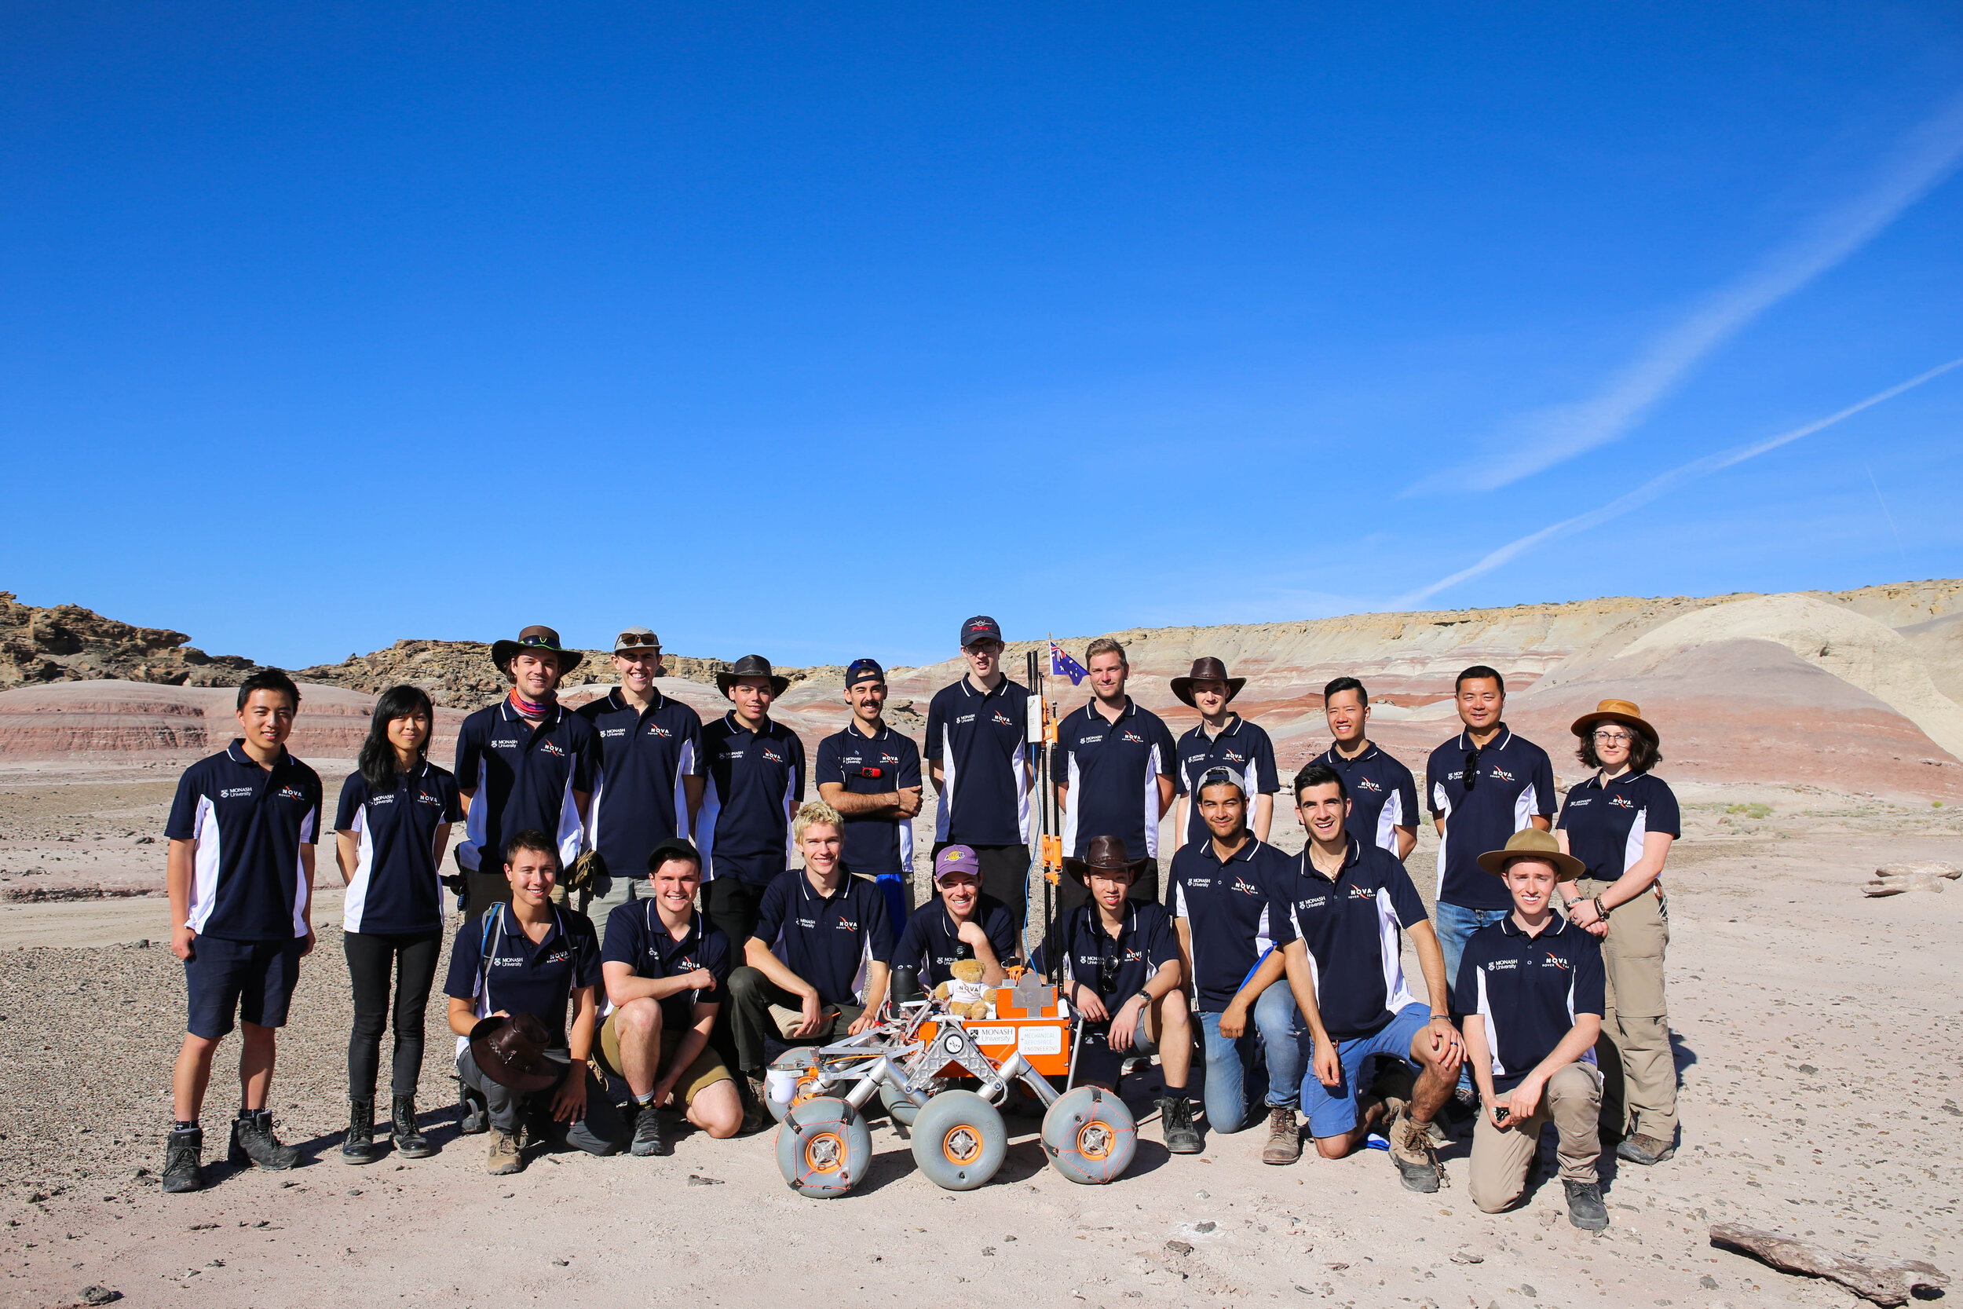
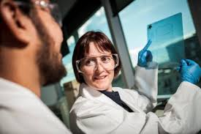

Connecting Organisations for Societal Impact
Session 1
About Monash University
Projecting an external message to develop relationships with government and business
Leveraging Infrastructure and enhancing collaboration
The big picture – how to attract investment
Session 2
Group discussion
Science and Technology for good in a COVID world. Adapting in times of crisis - Refining your plans as you seek to project a situational dependent message, leverage assets in a time of fiscal prudence and aspire to have impact as technology, innovation and science come to the forefront of community need.
Notes:
Building (long term) relations between Monash university, governments and businesses for
impact
Leveraging the societal impact that research infrastructure can deliver through enhanced
collaboration
Articulating aspiration and communicating achievements to attract investments

Slide 3

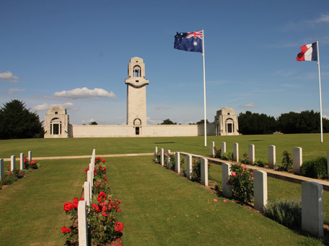
Monash University is named after
General Sir John Monash
The Sir John Monash Centre is a museum and that commemorates Australian servicemen and women who served on the Western Front during the First World War. The centre, located near the village of Villers-Bretonneux (Somme) in northern France, Australian National Memorial and within the military cemetery.
On 12 August 1918, at Château de Bertangles, Monash was knighted as a Knight Commander
of the Order of the Bath on the battlefield by
King George V.
Notes:
On 12 August 1918, at Château de Bertangles, Monash was knighted as a Knight Commander of the Order of the Bath on the battlefield by King George V.
The Sir John Monash Centre is a museum and interpretive centre that commemorates Australian servicemen and women who served on the Western Front during the First World War. The centre, located near the village of Villers-Bretonneux (Somme) in northern France, is set behind the Villers–Bretonneux Australian National Memorial and within the military cemetery. The centre opened in April 2018.
A great military commander, but also a leading civilian in engineering.

Slide 4
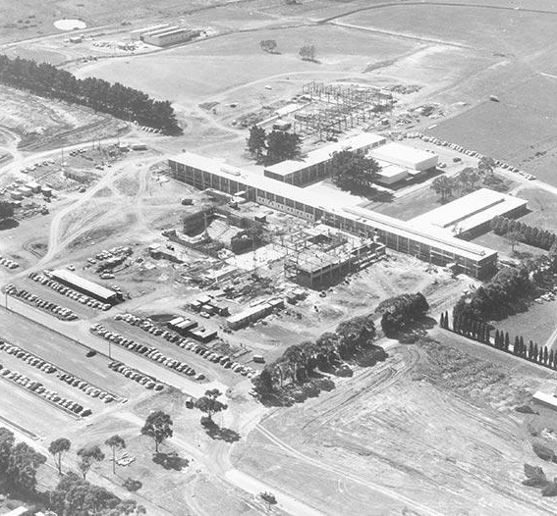
About Monash
1961
First student intake:
347
Melbourne’s population: 1.9 million
Our campus was on the ‘outskirts’ of Melbourne
Notes:
Melbourne is now a city of over 5 million people, we have grown with the city

Slide 5

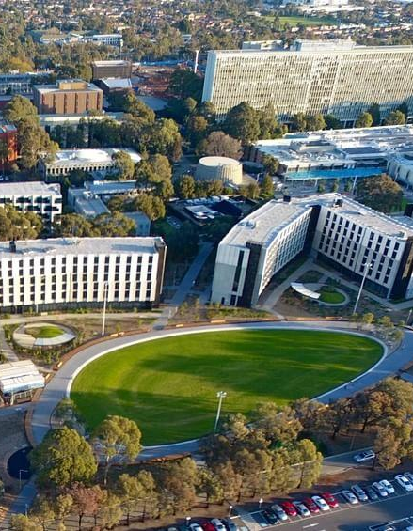
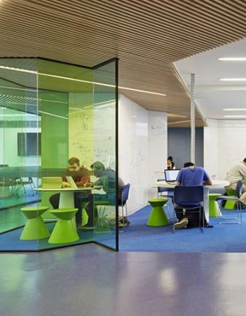


Monash University Today
Australia's largest university
Revenue of $2.9b annually
88,000 students
$1 Billion annual investment in R&D
First level – hero information largest
Second level – explanatory info smaller
Notes:
Melbourne is now a city of over 5 million people, we have grown with the city
Monash is a 10 Faculty University – Arts, Pharmacy, Business, Education, Engineering, Information Technology, Law, Science, Architecture and Medicine.

Slide 6
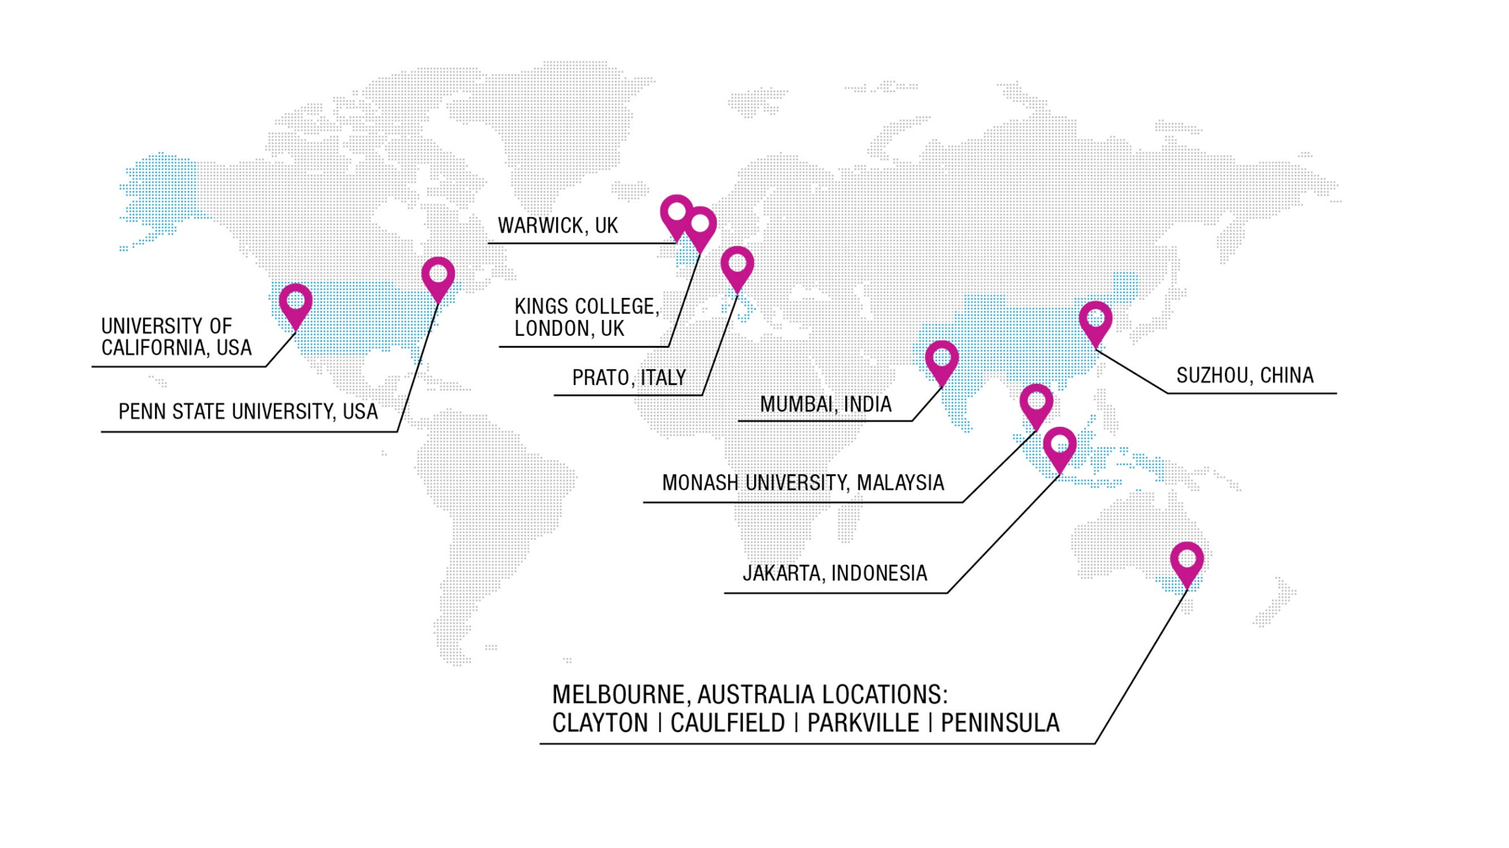
Monash University has a global footprint of campuses and strategic research partnerships
First student intake:
347
Melbourne’s population: 1.9 million
Clayton on the ‘outskirts’ of Melbourne
Notes:
Monash continued to advance our presence
and impact as Australia’s most international university.
The total number of students undertaking outbound study
experiences increased by 16 per cent to more than 5000,
demonstrating our increased offering of intercultural
learning experiences.

Slide 7

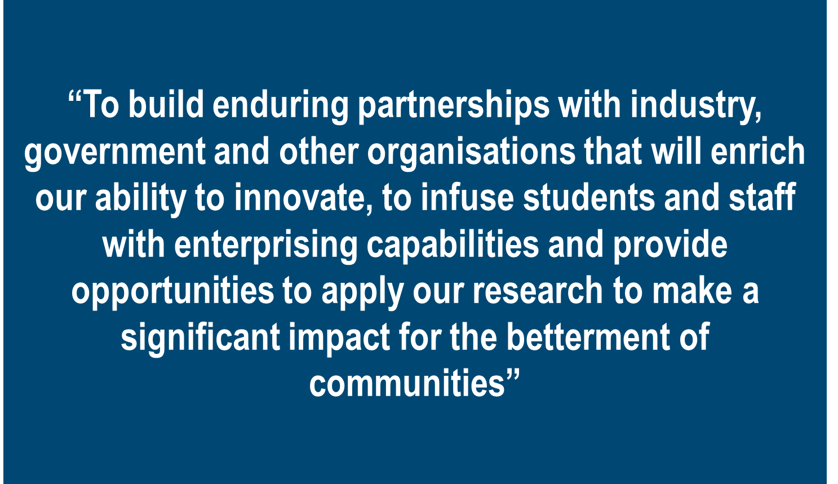
Monash Strategic Plan

Slide 8
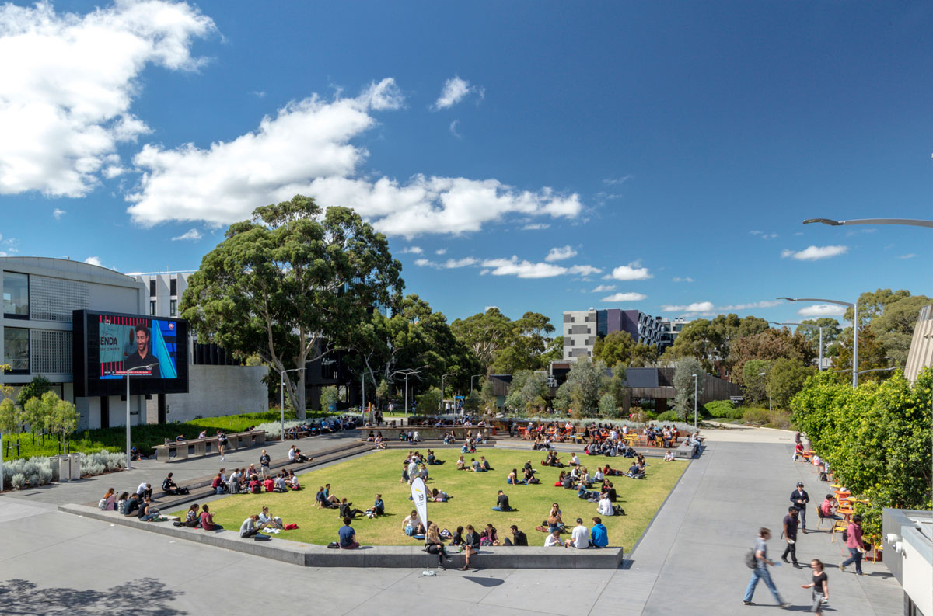
Projecting an external message to develop relationships with government and business
Strategic pillars:
To be Excellent, by undertaking research and education of the highest quality;
To be International, by building the strength, networks and scale of international research and education;
To be Enterprising, by promoting collaboration and innovation; and
To be Inclusive, by fostering diversity and openness both within Monash and with the wider community
First student intake:
347
Melbourne’s population: 1.9 million
Clayton on the ‘outskirts’ of Melbourne
Notes:
Building (long term) relations between Monash university, governments and businesses for
impact

Slide 9
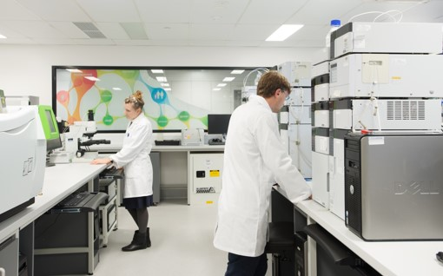
Projecting an external message to develop relationships with government and business
To be Excellent, by undertaking research and education of the highest quality
Excellent research
We will maintain and strengthen the
strategies that have proven effective
in enhancing research performance
Excellent education
We will work to ensure our curricula
are highly relevant. We will also
transform our pedagogy to reflect the
best available thinking and incorporate
appropriate technology.
First student intake:
347
Melbourne’s population: 1.9 million
Clayton on the ‘outskirts’ of Melbourne
Notes:
Excellent research
We will maintain and strengthen the strategies that have proven effective in enhancing research performance. Our excellence in this area will be distinguished by:
Talent: World-class research requires world-class talent. We will develop and recruit high-performing researchers and graduate research students from across the globe.
Focus: We will invest in areas where Monash has or is capable of having impact and research expertise of high international standing.
Infrastructure: We will invest in and maintain world-class research infrastructure that aligns with our research priorities and supports engagement with our research partners.
Interdisciplinarity: We will foster research that leverages the breadth of our expertise, bringing together disciplines to tackle major research challenges.
Excellent education
We will work to ensure our curricula are highly relevant. We will also transform our pedagogy to reflect the best available thinking and incorporate appropriate technology. Our excellence in this area will be distinguished by:
Talent: World-class education requires world-class talent. We will develop and recognise education excellence and ensure that we have roles that support innovation in curriculum and pedagogy.
Focus on student outcomes: We will increase our focus on the outputs as well as the inputs of education, including retention, timely completion, career success and the enhancement of our graduates’ skills.
Learning and teaching environment: We will support the best in pedagogy and flexible delivery through contemporary technologies and learning spaces and effective management of our education.

Slide 10
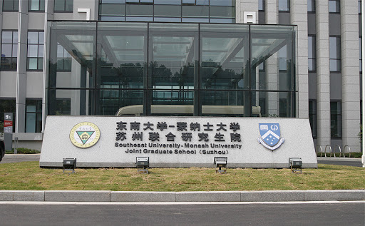
Projecting an external message to develop relationships with government and business
To be International, by building the strength, networks and scale of international research and education
International research
We will build our international
partnerships and offshore campuses
into a global research network.
International education
We will ensure that our students
graduate with an international outlook
and capabilities that reflect the
international character of the University
and prepare them for a globalised world.
First student intake:
347
Melbourne’s population: 1.9 million
Clayton on the ‘outskirts’ of Melbourne
Notes:
International research
We will build our international partnerships and offshore campuses into a global research network.
We will identify areas of collaboration across our networks and pay particular attention to linkages between higher degree by research students and supervisors.
b. All offshore campuses and partnerships will contribute to our research performance.
c. We will develop our institutional alliances with key international university partners to further the opportunities for international research and education.
International education
We will ensure that our students graduate with an international outlook and capabilities that reflect the international character of the University and prepare them for a globalised world.
We will diversify the countries from which we recruit students and the courses those students study.
We will work with our institutional partners and others to encourage greater student mobility, physical and virtual, and increase interaction between students from different countries.
We will ensure that both the curriculum and pedagogy inculcate the intercultural competence that will be a hallmark of a Monash education.

Slide 11
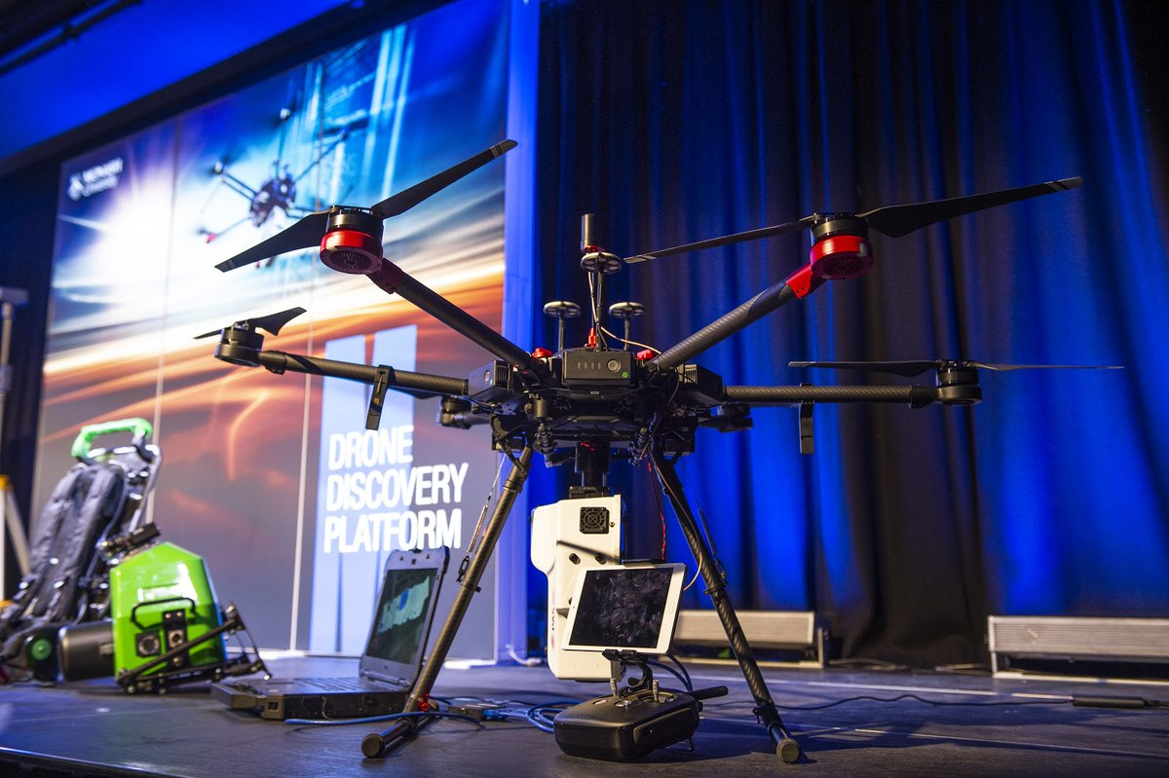
Projecting an external message to develop relationships with government and business
To be Enterprising, by promoting collaboration and innovation
Enterprising research
We will build deep partnerships with
organisations that have the national
and international reach necessary
to address major challenges
and have impact across regions
and populations.
Enterprising education
We will engage deeply with
government, industry and alumni to
ensure that the skills Monash students
learn prepare them for a successful
and varied career.
First student intake:
347
Melbourne’s population: 1.9 million
Clayton on the ‘outskirts’ of Melbourne
Notes:
Enterprising research
We will build deep partnerships with organisations that have the national and international reach necessary to address major challenges and have impact across regions and populations.
a. We will ensure our internal structures make it easy to collaborate with us.
b.We will foster a culture of innovation and align incentives to encourage engagement with external partners.
c. We will support the translation of our fundamental research to increase its impact.
Enterprising education
We will engage deeply with government, industry and alumni to ensure that the skills Monash students learn prepare them for a successful and varied career.
a. We will make direct engagement between students and industry and government partners – including projects and internships – a hallmark of a Monash education.
b. We will draw upon our research strengths and our partnerships to initiate a systematic process to help shape the professions of the future.
c. We will connect student skills development, both undergraduate and postgraduate, to practical issues and provide opportunities for students to develop their leadership
and entrepreneurial skills and business models for commercial and not-for-profit ventures

Slide 12
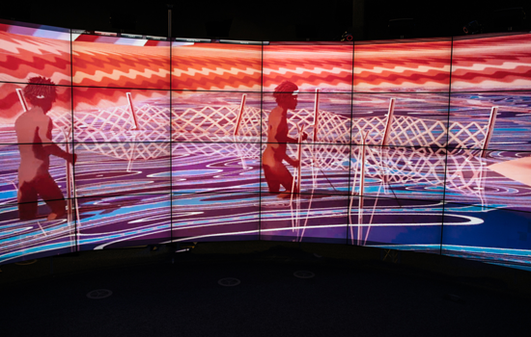
Projecting an external message to develop relationships with government and business
To be Inclusive, by fostering diversity and openness both within Monash and with the wider community
Inclusive education
Connection and belonging
Embracing alumni
Public outreach and understanding
First student intake:
347
Melbourne’s population: 1.9 million
Clayton on the ‘outskirts’ of Melbourne
Notes:
Inclusive education
In order to ensure we are educating the most talented students, we will develop and employ a highly targeted admissions program including pathways, transition approaches, and quotas and scholarships for students from disadvantaged backgrounds to increase access and success.
Connection and belonging
We need to support a superb experience for students and staff that enhances cohesion in a diverse community.
a. We will offer a broad range of co-curricular activities to develop student talents and community.
b.We will develop and reinforce student communities through increasing opportunities to live on campus or participate in virtual colleges.
c. We will foster in our students a sense of responsibility to change the world for the better and equip them with the skills to do so.
d.We will encourage student and staff interaction and innovation through effective digital environments and through well-planned campuses featuring formal and informal spaces that create vibrant, thriving social and cultural life.
Embracing alumni
Alumni have much to offer to help us build a stronger University. We will work to foster mutually beneficial relationships with them by building a global alumni network that leverages their expertise, perspectives and connections.
Public outreach and understanding
We will draw the wider community into dialogue with us by building on and expanding our proactive contribution to public discourse. We will open the life of our campuses to the surrounding community through high quality arts and sports precincts.

Slide 13
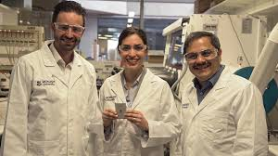
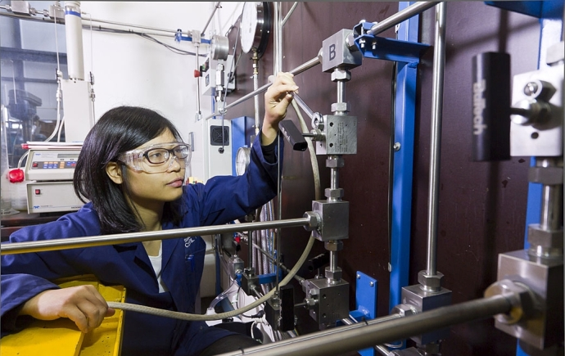
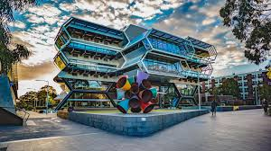
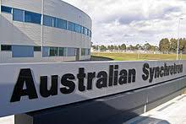
Leveraging Infrastructure and enhancing collaboration
People & Relationships
Tools
Knowledge
Capability
First level – hero information largest
Second level – explanatory info smaller
Notes:
People
including leaders in business, government, social enterprise, education, science and research leaders who attract collaborators and students to their work, as well as people in the services sector who play an important role in supporting facilities and providing services in the surrounding areas.
Relationships
formed between research institutions, business, industry and community stakeholders, students, teachers and alumni, building reputations and sustained learning.
Knowledge
flowing from research activities and through the university education system to equip students and business with new ideas, critical thinking and skills.
Tools
research facilities, specialist equipment and technical services.
Capability
such as computational and digital support for data analysis and improved advanced manufacturing processes.

Slide 14
Building the profile
First level – hero information largest
Second level – explanatory info smaller
Notes:
Identification and communication- be persistent with your message.

Slide 15

LEVERAGING AN ECO-SYSTEM FOR INNOVATION
Pfizer
AWS
Bosch
Alumni
Students
Commercial Partners
University Know-How
Bio-tech and Therapeutics
Johnson & Johnson
BHP Billion
Med-tech
State of the art research platforms
World class researchers
Knowledge-based industries
Agilent Technologies
Woodside
Government and Public Policy
CSIRO
Victorian Government
Local Government
Future Materials
Research Precinct
Australian Synchrotron
Government Partners
Data AI & Technology
Federal
Centre for Nanofabrication
Biomedical Imaging

Slide 16
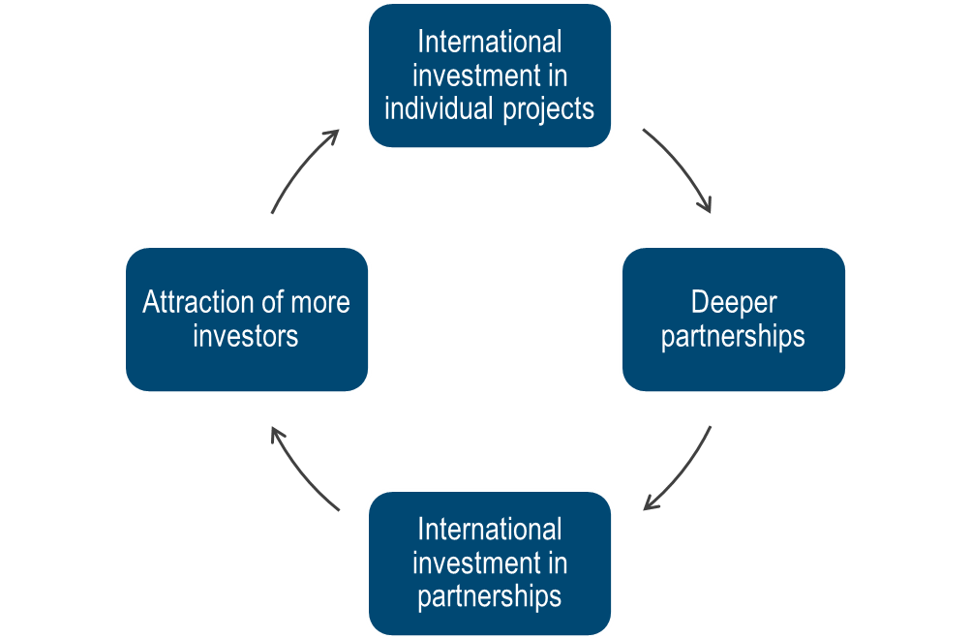
A focus on attracting investment
Current State
Long-during partnerships accelerate economic benefits to the Monash Precinct and Victoria
Deliver impact for industry
Co-location of major industry partners
Partners have early access to Monash University pipelines and platforms
Incubators, spin-outs, start-ups facilitate commercialisation
Other commercial / entrepreneurial activity develops
Critical mass of industry and innovation continues to build momentum
Industries elect to integrate their R&D function Monash
Notes:
The big picture – how to attract investment

Slide 17







A focus on attracting investment
Attract enterprise partners to enhance collaboration
An Enterprise led project, with a focus on enriching the ability of faculties to innovate
A foundation to build a self-sufficient innovation ecosystem, removing barriers to engagement between Monash and external partners
Investment, capabilities and innovation of commercial developers to share resources and risk
Expansion of the physical reach Monash through development on the boundary of campus integrating Monash activities with the surrounding employment precinct
A precinct directly connected to campus with walking and cycling connections
Space for research collaboration, product testing, enterprise reinvigoration, commercial amenity and start-up incubation
The opportunity to consolidate central professional staff accommodation, with Monash acting as the first “anchor tenant” for the site
Blur the campus boundary integrating with the precinct
Support the start-up and innovation eco-system
Monash
requirements
Catalyse development of the broader Monash precinct
Preserve Monash capital for core academic projects
Consolidate central professional staff accommodation

Slide 18






University-led industry collaboration hubs have inspired Monash
University- Industry Hub
Description
Key Learnings for Monash
Kennispark Twente, University of Twente, Netherlands
A collaboration of the University of Twente, six world renowned research institutes and enterprise spaces designed to be a whole community. It includes an incubator, Novel T, with a vision to become the best performing ecosystem for innovation and entrepreneurship in Europe.
Began in 1984 and is now a 1,300,000 m² site
The site includes the university, office and light industrial leases, retail, event space, accommodation and housing.
Providing a mix of space for enterprises helps develop a vibrant community of businesses of varying size and capability combining fresh ideas and proven wisdom
A defined pathway enables startups and small enterprises to grow and stay in the community through a supporting community and encouraging culture that nurtures entrepreneurs and their ideas.
Connections to complementary precincts provides an extended pathway to scale beyond Kennispark
Newcastle Helix, Newcastle University, United Kingdom
A collaboration between Newcastle University, Newcastle City Council and Legal and General to develop an innovation ecosystem aligned with research strengths, national and local priorities.
Developed on a 95,000 m² site
Including commercial office space, learning and teaching facilities, commercial lab space, university research centres, event space, retail and housing.
Aligning the development to the local commercial strengths and university research strengths creates mix use facilities where education, research and enterprise co-exist on a daily basis
A focus on national economic priorities assists with government funding and support
Building on a site away from the campus core extends the boundaries of the university further integrating it with the existing community

Slide 19
Communicating the investment proposition
INPUTS
VISION
OUTPUTS
Physical planning & infrastructure
Access to new markets and attraction of global investment
Dedicated people, capability & culture of trust
Accelerate innovative ideas and translation of new knowledge
Create high value jobs in
key industries
Access to investors and capital
Increased entrepreneurial activity, incl. start-ups and social enterprises
Connectivity
Improved liveability and connected community
Notes:
Demonstrating the opportunity
A journey for success

Slide 20
Objectives that underpin the proposition
1
The Education Objective
To provide excellent, international, enterprising and inclusive education, and ensure our students graduate with a greater sense of purpose, a global outlook, and the skills and confidence to make positive change
2
The Research and Innovation Objective
To solve grand challenges and set global agendas, underpinned by deep and enduring relationships with partners in industry, government, non-governmental organisations and other universities
3
The Industry / Job Creation Objective
To advance industry development and boost employment in priority sectors within the Precinct, driven by innovation, to increase productivity, prosperity and economic growth
4
The ‘Place Making’ Objective
A place to live, work and play, by enabling greater localisation of activities which contribute to enhanced liveability
5
The Connectivity Objective
To create better transport and connections that allows ideas to freely move
Notes:
Where we have focus is where we have purpose

Slide 21
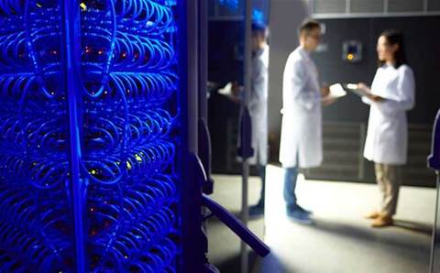
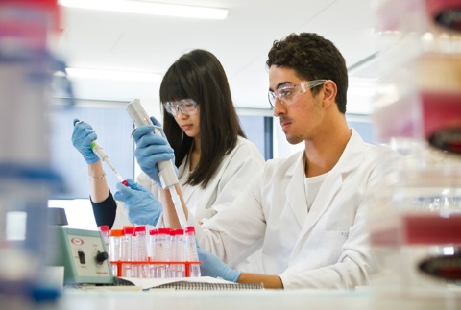
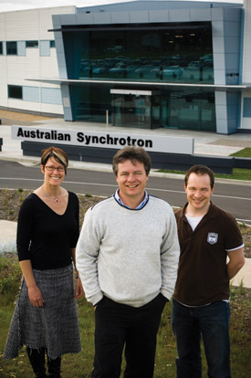
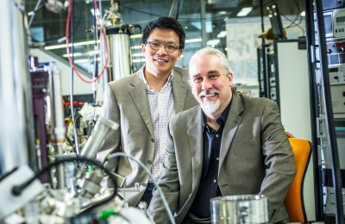

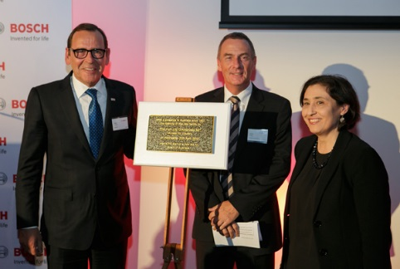
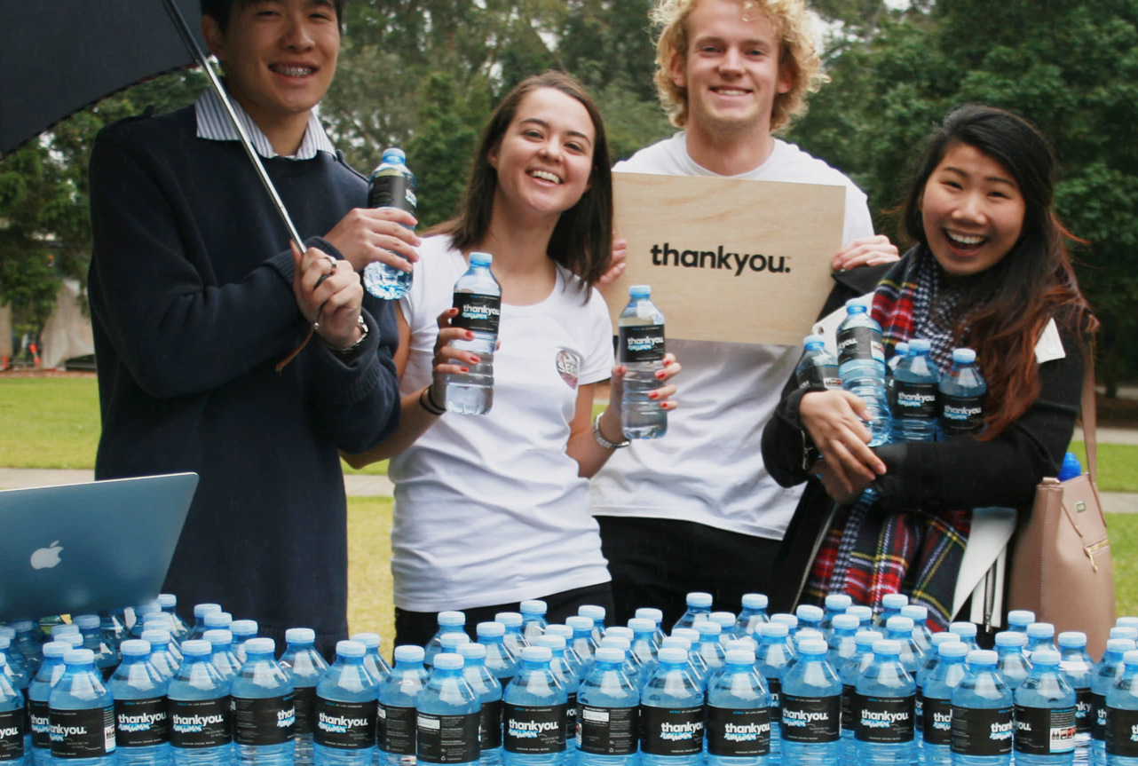
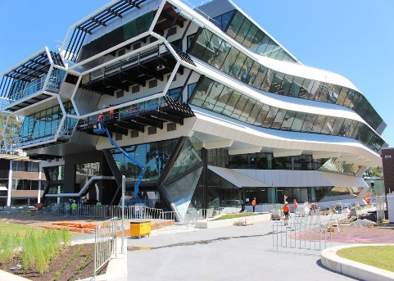
Benefits of the proposition
Knowledge Generation
and Innovation
Creation of High Value Jobs and Increased Productivity
Increased Employment in Priority Sectors
Collaboration and Enhancing Existing Scale
Improved Access to Health and Education Services
Increased Attractiveness
for International Investment
Increased entrepreneurship (start-ups & social enterprise)
Additional GSP and Value
Existing capability should be leveraged to continue to drive economic growth and community benefit

Slide 22
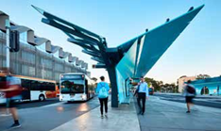
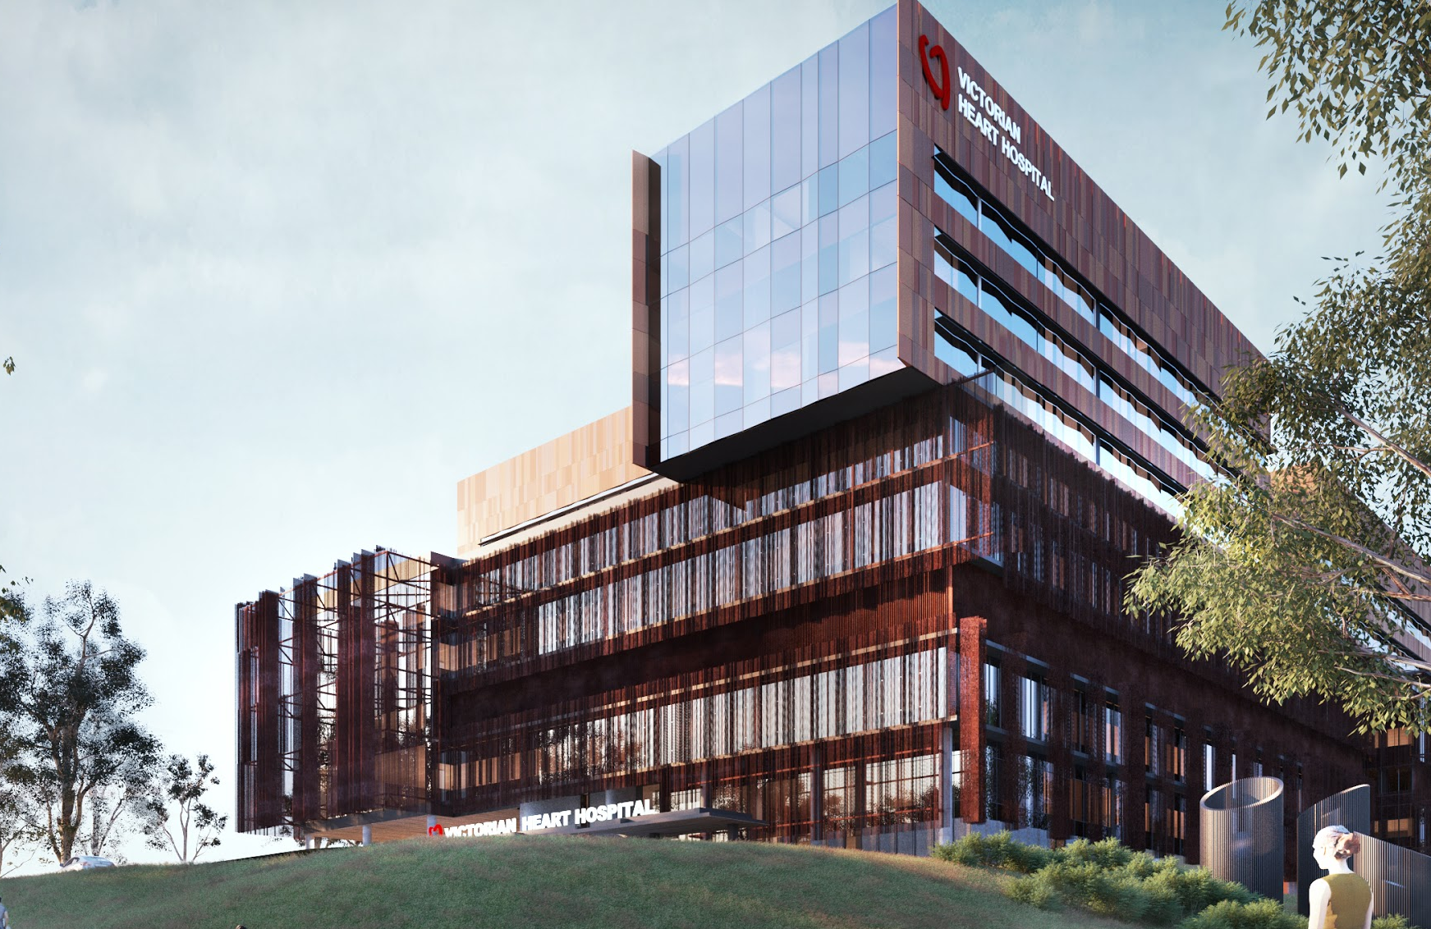
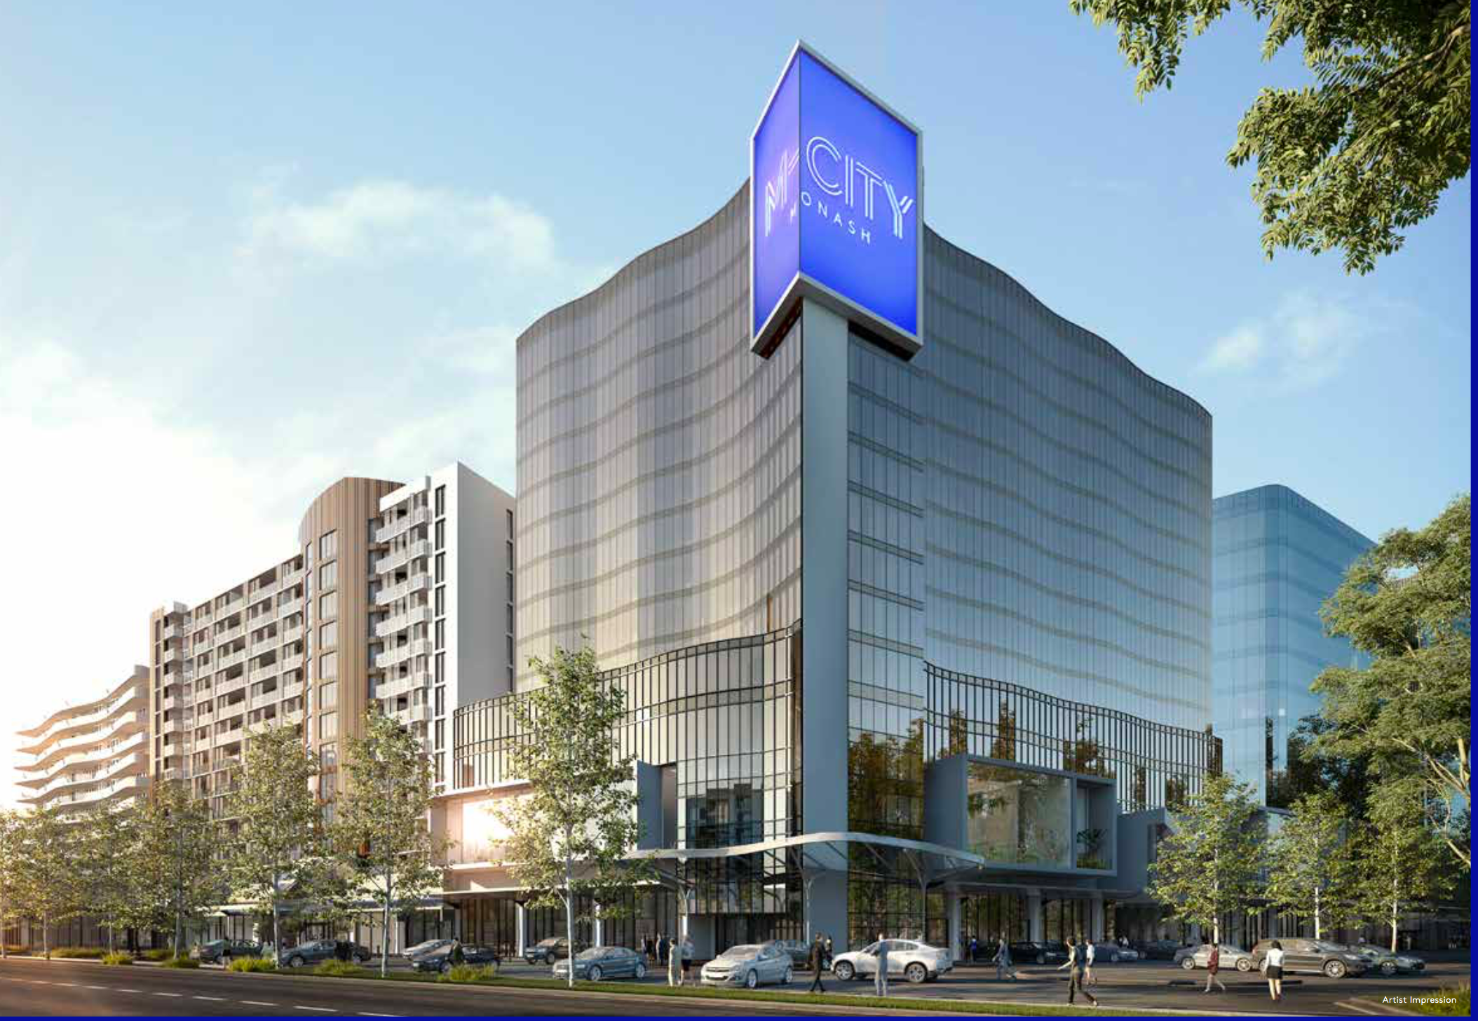
INVESTMENT ACHIEVED
SUBURBAN RAIL LOOP
$50B committed by Victorian Government
BUS INTERCHANGE
$8m by Monash University
AUSTRALIAN SYNCHROTRON
$520M funding from Federal Government
BOSCH OCEANIA HQ
$40M invested in Bosch headquarters in Clayton
IAN POTTER CENTRE FOR PERFORMING ARTS
$54M
BIOBANKING VICTORIA
$1.5M funding from Victorian Government.
WOODSIDE INNOVATION CENTRE
$40 M
NET ZERO INITIATIVE
$135M committed by Monash
MONASH SPORT
$23m by Monash University
VICTORIAN HEART HOSPITAL
$543M funding commitment by Victorian Government, Monash University and Monash Health
M-City Monash
$1B invested to develop mixed use residential, hotel, retail, hospitality

Slide 23
Comments and questions

Slide 24
Connecting Organisations for Societal Impact
Session 1
About Monash University
Projecting an external message to develop relationships with government and business
Leveraging Infrastructure and enhancing collaboration
The big picture – how to attract investment
Session 2
Group discussion
Group discussion
Science and Technology for good in a COVID world. Adapting in times of crisis - Refining your plans as you seek to project a situational dependent message, leverage assets in a time of fiscal prudence and aspire to have impact as technology, innovation and science come to the forefront of community need.

Slide 25
Monash Strategic Plan

